Slide 1

Network Design and Security Implementation of a Hospital System
PREPARED BY
1.Mohamed Abdo Abdel Sattar 2. Abdallah Gamal Mobarak 3.Ousaid Ashraf Mosbah
4. Ahmed Ghaly Gomaa 5.Mohamed Ahmed Khalil 6.Zeyad Mohamed Abdelwaris

Slide 2
Agenda
Network Design.
Basic settings and SSH to all routers and switches.
DHCP
NTP & SYSLOG
VLANS.
Subnetting And IP Addressing.
OSPF and Static Route.
Switch Security
Inter-VLAN Routing
Access Control List

Slide 3
Objective
In this project, we have an organization consisting of two branches, each branch contains several Switches, devices, and users, and we have a server Room.
The network has a hierarchical model with two already purchased Core routers (one at HQ-Network and one at BR-Network) each connecting to two subscribed ISPs.
Minimize Latency and Ensure High Performance: Enhance network performance by reducing latency in data transmission between different devices, which is crucial in hospital environments where many applications rely on real-time data transfer.
The network security policy will comprehensively dictate the user's access to each site using an Access Control List (ACL).

Slide 4
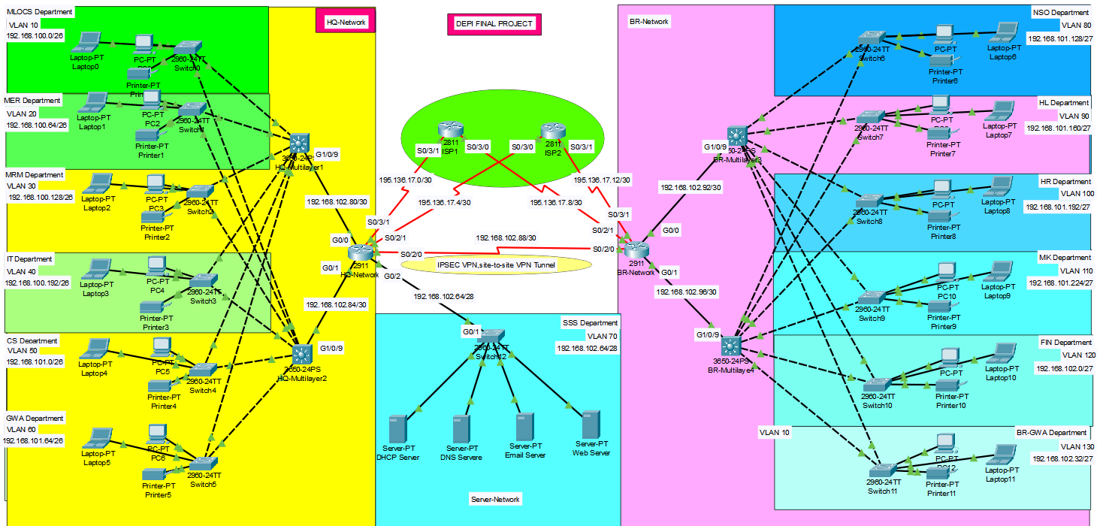
Network Design

Slide 5
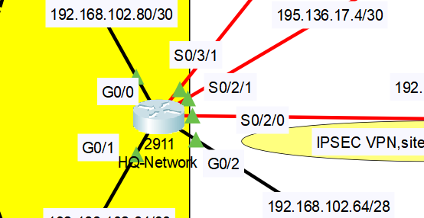
Basic Settings
Commands
en
conf t
hostname BR-Router
enable password cisco
banner motd #No Unauthorised Access!!!#
no ip domain lookup
line console 0
password cisco
login
exit
service password-encryption

Slide 6
SSH
SSH (Secure Shell) is a cryptographic network protocol used for securely accessing and managing devices over an unsecured network. It provides encrypted communication between a client and a server, ensuring confidentiality, data integrity, and authentication. SSH is commonly used for remote login
Commands
ip domain name cisco.net
username admin password cisco
crypto key generate rsa
1024
line vty 0 15
login local
transport input ssh
exit

Slide 7
VLANS
A VLAN (Virtual Local Area Network) is a logical grouping of devices on a network, regardless of their physical location, that are configured to communicate as if they are on the same physical network segment.
What are the advantages of VLAN?
VLANs allow you to segment a network into multiple broadcast domains, which enhances network performance, security, and manageability.

Slide 8
Commands
Layer 2 Switches
Layer 3 Switches
Vlan 10
name MLOCS
exit
int ra g0/1-2
switchport mode trunk
exit
int ra f0/1-24
switchport mode access
switchport access vlan 10
exit
HQ-Network Side
vlan 10
vlan 20
vlan 30
vlan 40
vlan 50
vlan 60
exit
int ra g 1/0/1-7
switchport mode trunk
exit
BR_Network Side
vlan 80
vlan 90
vlan 100
vlan 110
vlan 120
vlan 130
exit
int ra g 1/0/1-7
switchport mode trunk
exit
And so on in all Switches

Slide 9
DHCP
DHCP (Dynamic Host Configuration Protocol) is a network management protocol used to automate the process of assigning IP addresses and other network configuration parameters (such as the default gateway, DNS servers, and subnet masks) to devices (clients) on a network.
This eliminates the need for manually configuring IP addresses for each device, making it a more efficient and scalable approach.

Slide 10
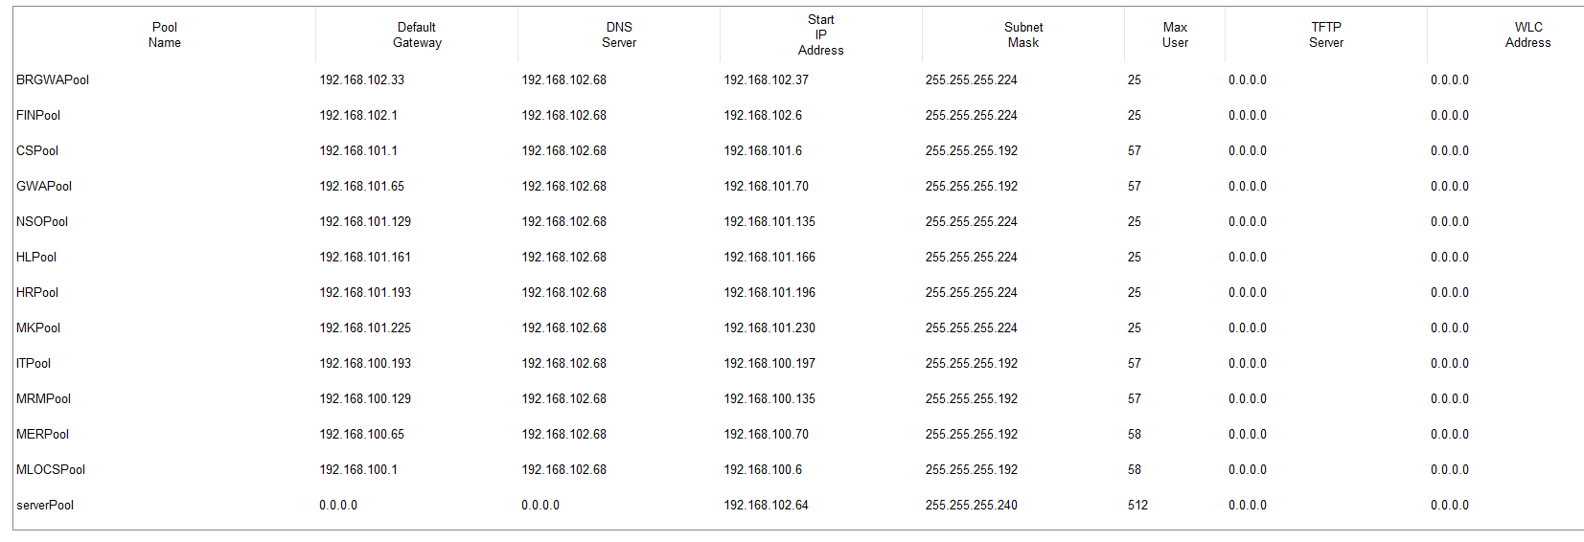
DHCP Pool Configuration:
This table shows the configuration of multiple DHCP pools for different departments and services in a network. Each pool defines the range of IP addresses that the DHCP server can assign to devices within that specific department

Slide 11
NTP
NTP (Network Time Protocol) is a protocol used to synchronize the clocks of computers and network devices over a network.
It ensures that all devices share the same accurate time, which is critical for systems that depend on synchronized timing.

Slide 12
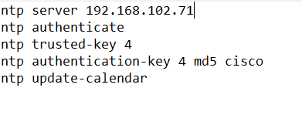

NTP Configuration:
Time and date before NTP
Time and date after NTP

Slide 13
SYSLOG
SYSLOG is a standard protocol used for sending and receiving log messages from network devices and servers. It allows devices to send log data to a centralized log server, which is essential for monitoring and troubleshooting network activity.
Benefits of Using a Syslog Server:
Centralized Logging
Improved Security
Log Retention
Monitoring & Alerting
Analysis & Reporting

Slide 14
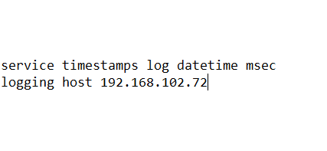
Syslog Command:
] 192.168.102.72 [ THAT IS THE IP FOR SYSLOG SERVER.

Slide 15
EXAMPLE OF SYSLOG
The SYSLOG feature is crucial for tracking login activities on network devices. In this example:
Timestamp: Displays the exact time the login event occurred, providing precise tracking of user access.
Hostname (192.168.102.90): Identifies the device where the login activity took place.
Log Messages:
Configuration Change: The message "%SYS-5-CONFIG_I: Configured from console by console" indicates that a configuration change was made via the device's console, highlighting administrative actions.
Logging Initiation: The message "%SYS-6-LOGGINGHOST_STARTSTOP: Logging to host 192.168.102.72 port 514 started - CLI initiated" indicates that the device began sending SYSLOG messages to another host at 192.168.102.72 using port 514, commonly used for SYSLOG servers.

Slide 16
Inter VLAN Routing
Inter-VLAN Routing is the process of forwarding packets between different Virtual Local Area Networks (VLANs). It allows devices in different VLANs to communicate with each other, which is essential for network segmentation and management.
Implementation Methods
Layer 3 Switch

Slide 17
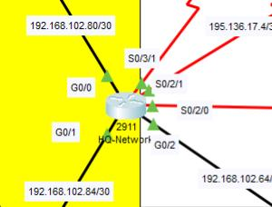
Router configuration for default getaway
HQ-Router(config-if)#no ip address HQ-Router(config-if)#exit HQ-Router(config)#interface GigabitEthernet0/2 HQ-Router(config-if)#interface GigabitEthernet0/2.70 HQ-Router(config-subif)# HQ-Router(config-subif)#encapsulation dot1Q 70 HQ-Router(config-subif)#ip address 192.168.102.65 255.255.255.240 HQ-Router(config-subif)#ex HQ-Router(config)#do wr Building configuration…

Slide 18
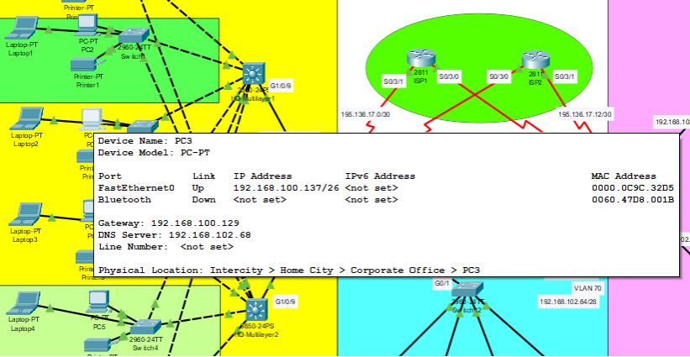
Inter-VLAN configuration for multilayer switch (vlan 10-60)
HQ-ML1(config)#int vlan 10 HQ-ML1(config-if)#ip address 192.168.100.1 255.255.255.192 HQ-ML1(config-if)#ip helper-address 192.168.102.67 HQ-ML1(config-if)# HQ-ML1(config-if)#int vlan 20 HQ-ML1(config-if)#ip address 192.168.100.65 255.255.255.192 HQ-ML1(config-if)#ip helper-address 192.168.102.67 HQ-ML1(config-if)# HQ-ML1(config-if)#int vlan 30 HQ-ML1(config-if)#ip address 192.168.100.129 255.255.255.192 HQ-ML1(config-if)#ip helper-address 192.168.102.67 HQ-ML1(config-if)# HQ-ML1(config-if)#int vlan 40 HQ-ML1(config-if)#ip address 192.168.100.193 255.255.255.192 HQ-ML1(config-if)#ip helper-address 192.168.102.67 HQ-ML1(config-if)# HQ-ML1(config-if)#int vlan 50 HQ-ML1(config-if)#ip address 192.168.101.1 255.255.255.192 HQ-ML1(config-if)#ip helper-address 192.168.102.67 HQ-ML1(config-if)# HQ-ML1(config-if)#int vlan 60 HQ-ML1(config-if)#ip address 192.168.101.65 255.255.255.192 HQ-ML1(config-if)#ip helper-address 192.168.102.67

Slide 19
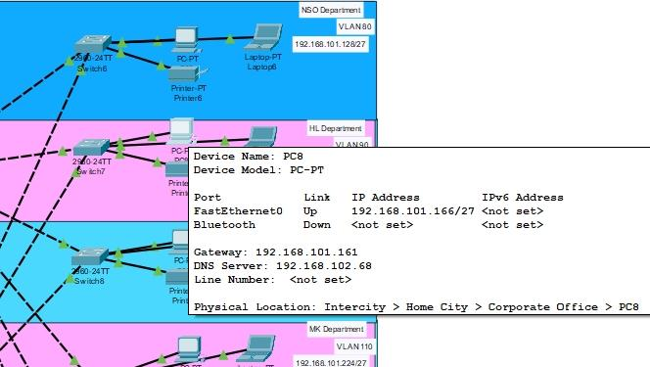
Inter-VLAN configuration for multilayer switch (vlan 80-130)
BR-ML1(config)#int vlan 80 BR-ML1(config-if)#ip address 192.168.101.129 255.255.255.224 BR-ML1(config-if)#ip helper-address 192.168.102.67 BR-ML1(config-if)# BR-ML1(config-if)#int vlan 90 BR-ML1(config-if)#ip address 192.168.101.161 255.255.255.224 BR-ML1(config-if)#ip helper-address 192.168.102.67 BR-ML1(config-if)# BR-ML1(config-if)#int vlan 100 BR-ML1(config-if)#ip address 192.168.101.193 255.255.255.224 BR-ML1(config-if)#ip helper-address 192.168.102.67 BR-ML1(config-if)# BR-ML1(config-if)#int vlan 110 BR-ML1(config-if)#ip address 192.168.101.255 255.255.255.224 Bad mask /27 for address 192.168.101.255 BR-ML1(config-if)#ip helper-address 192.168.102.67 BR-ML1(config-if)# BR-ML1(config-if)#int vlan 120 BR-ML1(config-if)#ip address 192.168.102.1 255.255.255.224 BR-ML1(config-if)#ip helper-address 192.168.102.67 BR-ML1(config-if)# BR-ML1(config-if)#int vlan 130 BR-ML1(config-if)#ip address 192.168.102.33 255.255.255.224 BR-ML1(config-if)#ip helper-address 192.168.102.67

Slide 20
IP subnetting
Benefits of Subnetting:
IP Addressing is the system used to assign unique numerical labels to devices connected to a computer network. These labels allow devices to communicate with each other
Subnetting divides a network into smaller segments to improve management, security, and performance.
Improved Network Performance: Reduces broadcast domains, limiting traffic within subnets.

Slide 21
How Does Subnetting Work?
Subnetting allows you to organize and manage large networks more efficiently by dividing them into smaller, logical groups.
Example:
Class C IP Address: 192.168.1.0
Subnet Mask: 255.255.255.128
In this case, the subnet mask shows that the first 24 bits represent the network address, while the remaining 8 bits are allocated for the host addresses. This setup permits a maximum of 126 hosts within the subnet.

Slide 22

Switch Security
1. Port Security
2. Mitigate VLAN Attacks
3. Mitigate DHCP Attacks
4. Mitigate ARP Attacks
5. Mitigate STP Attacks)

Slide 23
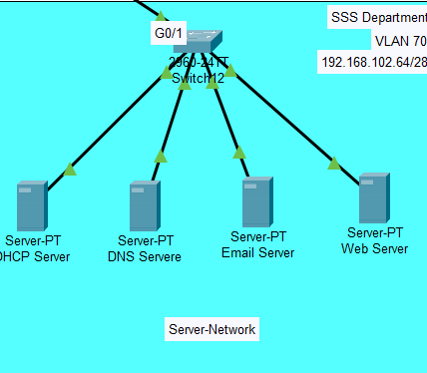
Port Security Configuration
int ra f0/1-24
switchport port-security
switchport port-security maximum 1
switchport port-security mac-address sticky
switchport port-security violation shutdown
ex
do wr

Slide 24
Vlan-Security
DHCP-Security
ip dhcp snooping
ip dhcp snooping vlan 80,90,100,110,120,130
int ra g0/1-2
ip dhcp snooping trust
int ra f0/1-3
ip dhcp snooping limit rate 6
do wr
int ra g0/1-2
switchport mode trunk
switchport trunk native vlan 99
switchport nonegotiate
int ra f0/4-24
sh
do wr

Slide 25
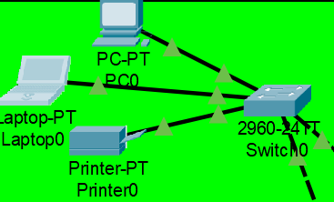
ARP-Security
STP-security
ip arp inspection vlan 10,20,30,40,50,60
ip arp inspection validate src-mac dst-mac ip
int ra g0/1-2
ip arp inspection trust
do wr
int ra f0/1-3
spanning-tree portfast
spanning-tree bpduguard enable
do wr

Slide 26
OSPF
Open Shortest Path First (OSPF) is a routing protocol for Internet Protocol (IP) networks. It uses a link state routing (LSR) algorithm and falls into the group of interior gateway protocols (IGPs).
OSPF States:
Down: Initial state.
Init: OSPF has received a hello packet from a neighbor but hasn't yet bidirectional communication.
Two-Way: Bidirectional communication established.
ExStart: Routers negotiate the master/slave relationship(DR&BDR).
Exchange: Routers exchange link-state information.
Loading: Routers request and receive link-state updates.
Full: OSPF adjacency is fully established, and the routers have the same link-state databases.

Slide 27
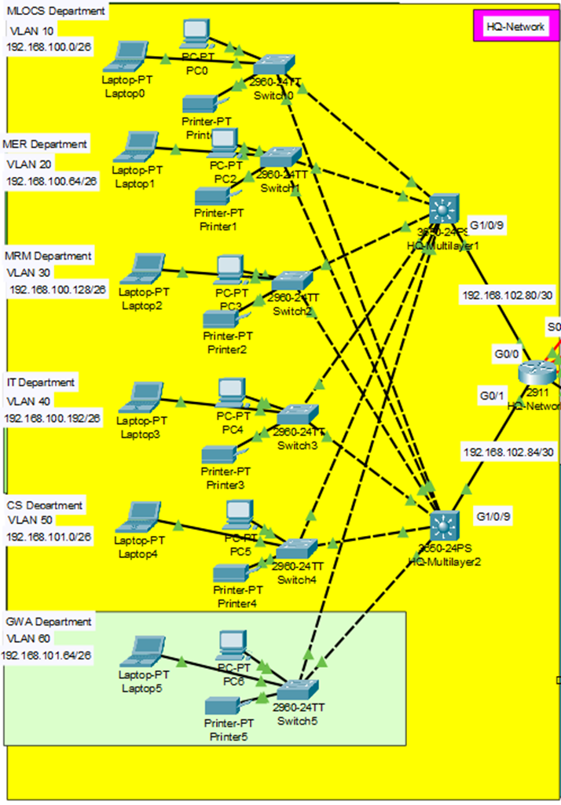
OSPF & Static Route Configuration
HQ-ML1 Layer 3 Switch
ip routing
router ospf 10
network 192.168.100.0 0.0.0.63 area 0
network 192.168.100.64 0.0.0.63 area 0
network 192.168.100.128 0.0.0.63 area 0
network 192.168.100.192 0.0.0.63 area 0
nenetwork 192.168.101.64 0.0.0.63 area 0
network twork 192.168.101.0 0.0.0.63 area 0
192.168.102.80 0.0.0.3 area 0
Ex
ip route 0.0.0.0 0.0.0.0 192.168.102.82
do wr
The Same Configuration for HQ-ML2

Slide 28
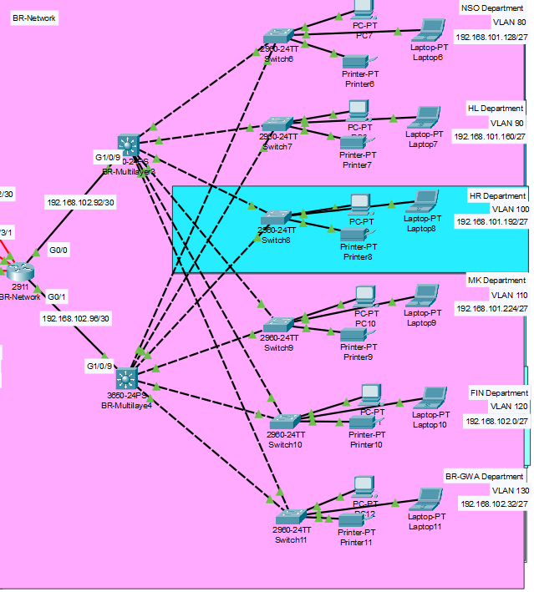
OSPF & Static Route Configuration
BR-ML1 Layer 3 Switch
ip routing
router ospf 10
network 192.168.101.128 0.0.0.31 area 0
network 192.168.101.160 0.0.0.31 area 0
network 192.168.101.192 0.0.0.31 area 0
network 192.168.101.224 0.0.0.31 area 0
network 192.168.102.0 0.0.0.31 area 0
network 192.168.102.32 0.0.0.31 area 0
network 192.168.102.92 0.0.0.3 area 0
Ex
ip route 0.0.0.0 0.0.0.0 192.168.102.94
do wr
The Same Configuration for BR-ML2

Slide 29
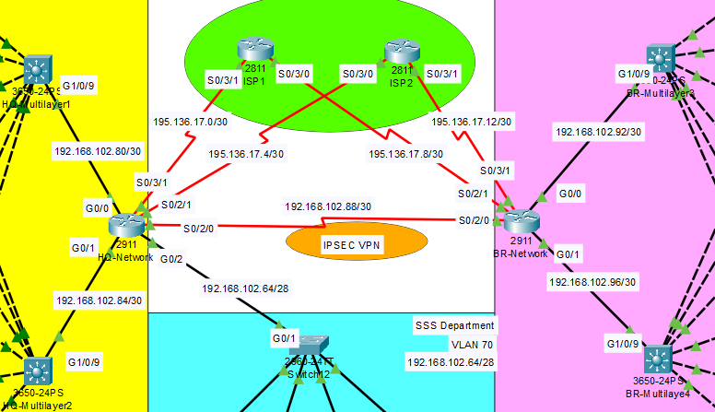
OSPF & Static Route Configuration
HQ-Router
router ospf 10
network 192.168.102.80 0.0.0.3 area 0
network 192.168.102.84 0.0.0.3 area 0
network 192.168.102.64 0.0.0.15 area 0
network 192.168.102.88 0.0.0.3 area 0
network 195.136.17.4 0.0.0.3 area 0
network 195.136.17.0 0.0.0.3 area 0
Ex
ip route 0.0.0.0 0.0.0.0 195.136.17.2
ip route 0.0.0.0 0.0.0.0 195.136.17.6 70
do wr

Slide 30
OSPF & Static Route Configuration
BR-Router
router ospf 10
network 192.168.102.92 0.0.0.3 area 0
network 192.168.102.96 0.0.0.3 area 0
network 192.168.102.88 0.0.0.3 area 0
network 195.136.17.8 0.0.0.3 area 0
network 195.136.17.12 0.0.0.3 area 0
Ex
ip route 0.0.0.0 0.0.0.0 195.136.17.14
ip route 0.0.0.0 0.0.0.0 195.136.17.10 70
do wr

Slide 31

OSPF & Static Route Configuration
ISP1
router ospf 10
network 195.136.17.0 0.0.0.3 area 0
network 195.136.17.8 0.0.0.3 area 0
ex
do wr
ISP2
router ospf 10
network 195.136.17.4 0.0.0.3 area 0
network 195.136.17.12 0.0.0.3 area 0
ex
do wr

Slide 32
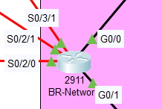
NAT Overload
Introduction to Overloading Interfaces in NAT Configuration
What is NAT Overload?
NAT (Network Address Translation) Overload, also known as PAT (Port Address Translation), is a method used to map multiple private IP addresses to a single public IP address using different ports.
Purpose: NAT overload allows multiple devices on a private network to share a single public IP for internet access, efficiently conserving IP addresses.
Key Features of NAT Overload:
Efficient Use of IP Addresses: Enables multiple internal devices to access external networks using one public IP address.
Port-Based Mapping: Each internal device is assigned a unique port number, allowing for multiple simultaneous connections.
Security Enhancement: Hides internal network structure by masking private IP addresses behind a single public IP.

Slide 33
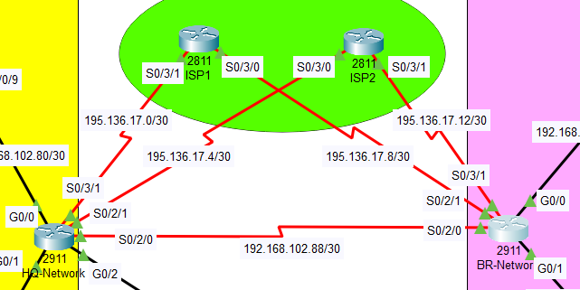
Configuring NAT Overload
Steps to Configure NAT Overload on a Router:
Define Inside and Outside Interfaces:
Designate interfaces as either inside (private network) or outside (public network).
Example commands in Cisco routers:
BR-Router(config)#int S0/2/1
BR-Router(config-if)#ip nat outside
BR-Router(config-if)#int S0/3/1
BR-Router(config-if)#ip nat outside
BR-Router(config-if)#exit
BR-Router(config)#int range gig0/0-1
BR-Router(config-if-range)#ip nat inside

Slide 34
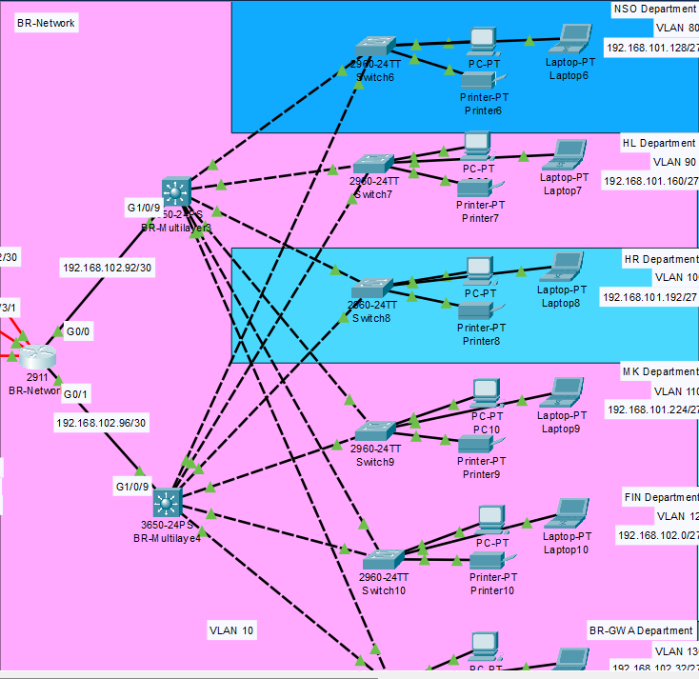
2. Configure NAT Overload:
Apply NAT overload on the public interface using the overload keyword.
Example:
BR-Router(config)#ip nat inside source list 1 interface se0/2/1 overload
BR-Router(config)#ip nat inside source list 1 interface se0/3/1 overload
3. Define an Access Control List (ACL):
Define which internal IPs can use NAT.
Example:
BR-Router(config)#access-list 1 permit 192.168.101.128 0.0.0.31
BR-Router(config)#access-list 1 permit 192.168.101.160 0.0.0.31
BR-Router(config)#access-list 1 permit 192.168.101.192 0.0.0.31
BR-Router(config)#access-list 1 permit 192.168.101.224 0.0.0.31
BR-Router(config)#access-list 1 permit 192.168.101.224 0.0.0.31
BR-Router(config)#access-list 1 permit 192.168.102.0 0.0.0.31
BR-Router(config)#access-list 1 permit 192.168.102.32 0.0.0.31

Slide 35
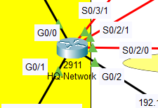
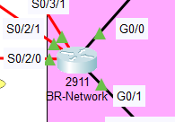
Extended Access Control
Commands
HQ-Router(config)#access-list 110 permit ip 192.168.100.0 0.0.0.255 192.168.101.128 0.0.0.255
HQ-Router(config)#access-list 110 permit ip 192.168.101.0 0.0.0.127 192.168.101.128 0.0.0.255
HQ-Router(config)#do wr
BR-Router(config)#access-list 110 permit ip 192.168.101.128 0.0.0.255 192.168.100.0 0.0.0.255
BR-Router(config)#access-list 110 permit ip 192.168.101.128 0.0.0.255 192.168.101.0 0.0.0.127
BR-Router(config)#do wr
Ethernet Key Exchange
Define the Internet Key Exchange (IKE) policies to secure the initial VPN handshake.
Commande
HQ-Router(config)# crypto isakmp policy 10
HQ-Router(config-isakmp)# encryption aes 256
BR-Router(config)#crypto isakmp policy 10
BR-Router(config-isakmp)# encryption aes 256

Slide 36
Authentication
Commands
HQ-Router(config-isakmp)# authentication pre-share
HQ-Router(config-isakmp)# group 5
HQ-Router(config)# crypto isakmp key vpnpa55 address 192.168.102.90
HQ-Router(config)# do wr
HQ-Router(config)# crypto ipsec transform-set VPN-SET esp-aes esp-sha-hmac
BR-Router(config-isakmp)# authentication pre-share
BR-Router(config-isakmp)# group 5
BR-Router(config)# crypto isakmp key vpnpa55 address 192.168.102.89
BR-Router(config)# do wr
BR-Router(config)# crypto ipsec transform-set VPN-SET esp-aes esp-sha-hmac

Slide 37
Crypto map
is the backbone of IPSec VPN implementation, enabling secure, targeted, and managed data transfer across networks.
Commands
HQ-Router(config)# crypto map VPN-MAP 10 ipsec-isakmp
HQ-Router(config-crypto-map)# ser peer 192.168.102.90
HQ-Router(config-crypto-map)# set transform-set VPN-SET
HQ-Router(config-crypto-map)# match address 110
HQ-Router(config)# interface Serial0/3/0
HQ-Router(config-if)# crypto map VPN-MAP
HQ-Router(config)# do wr
HQ-Router(config)#do sh crypto ipsec sa
BR-Router(config)# crypto map VPN-MAP 10 ipsec-isakmp
BR-Router(config-crypto-map)# ser peer 192.168.102.89
BR-Router(config-crypto-map)# set transform-set VPN-SET
BR-Router(config-crypto-map)# match address 110
BR-Router(config)# interface Serial0/2/0
BR-Router(config-if)# crypto map VPN-MAP
BR-Router(config)# do wr
BR-Router(config)#do sh crypto ipsec sa

Slide 38
Thanks

